Slide 1
Design and Optimization of Deterministic Finite Automata in Hardware
M A N O

Slide 2


INTRODUCTION:
In this presentation, we explore and
their crucial role in . We will discuss design methodologies and optimization techniques that enhance performance in
. Understanding these concepts is essential for developing efﬁcient algorithms in various applications.

Slide 3


Understanding DFA Basics
A is a
theoretical model of computation that processes input strings to determine if they belong to a speciﬁc language. Each state has a single transition for each input symbol, making it . This slide covers the fundamental components: states, transitions, and acceptance criteria.

Slide 4





Importance of Pattern Recognition
is vital in various
,
, and
ﬁelds, including
. DFAs play a signiﬁcant role in recognizing patterns efﬁciently. This slide highlights real-world applications and the signiﬁcance of optimizing DFAs for better performance.

Slide 5





Methodologies
Designing an efﬁcient DFA involves several methodologies, such as
and
. These techniques reduce the number of states and transitions, leading to a more compact representation. This slide discusses various design strategies and their impact on performance in hardware.

Slide 6
Optimization techniques for DFAs include ,
, and
. These methods enhance the speed and efﬁciency of pattern recognition tasks. This slide provides an overview of each technique and its beneﬁts when implemented in hardware systems.

Slide 7
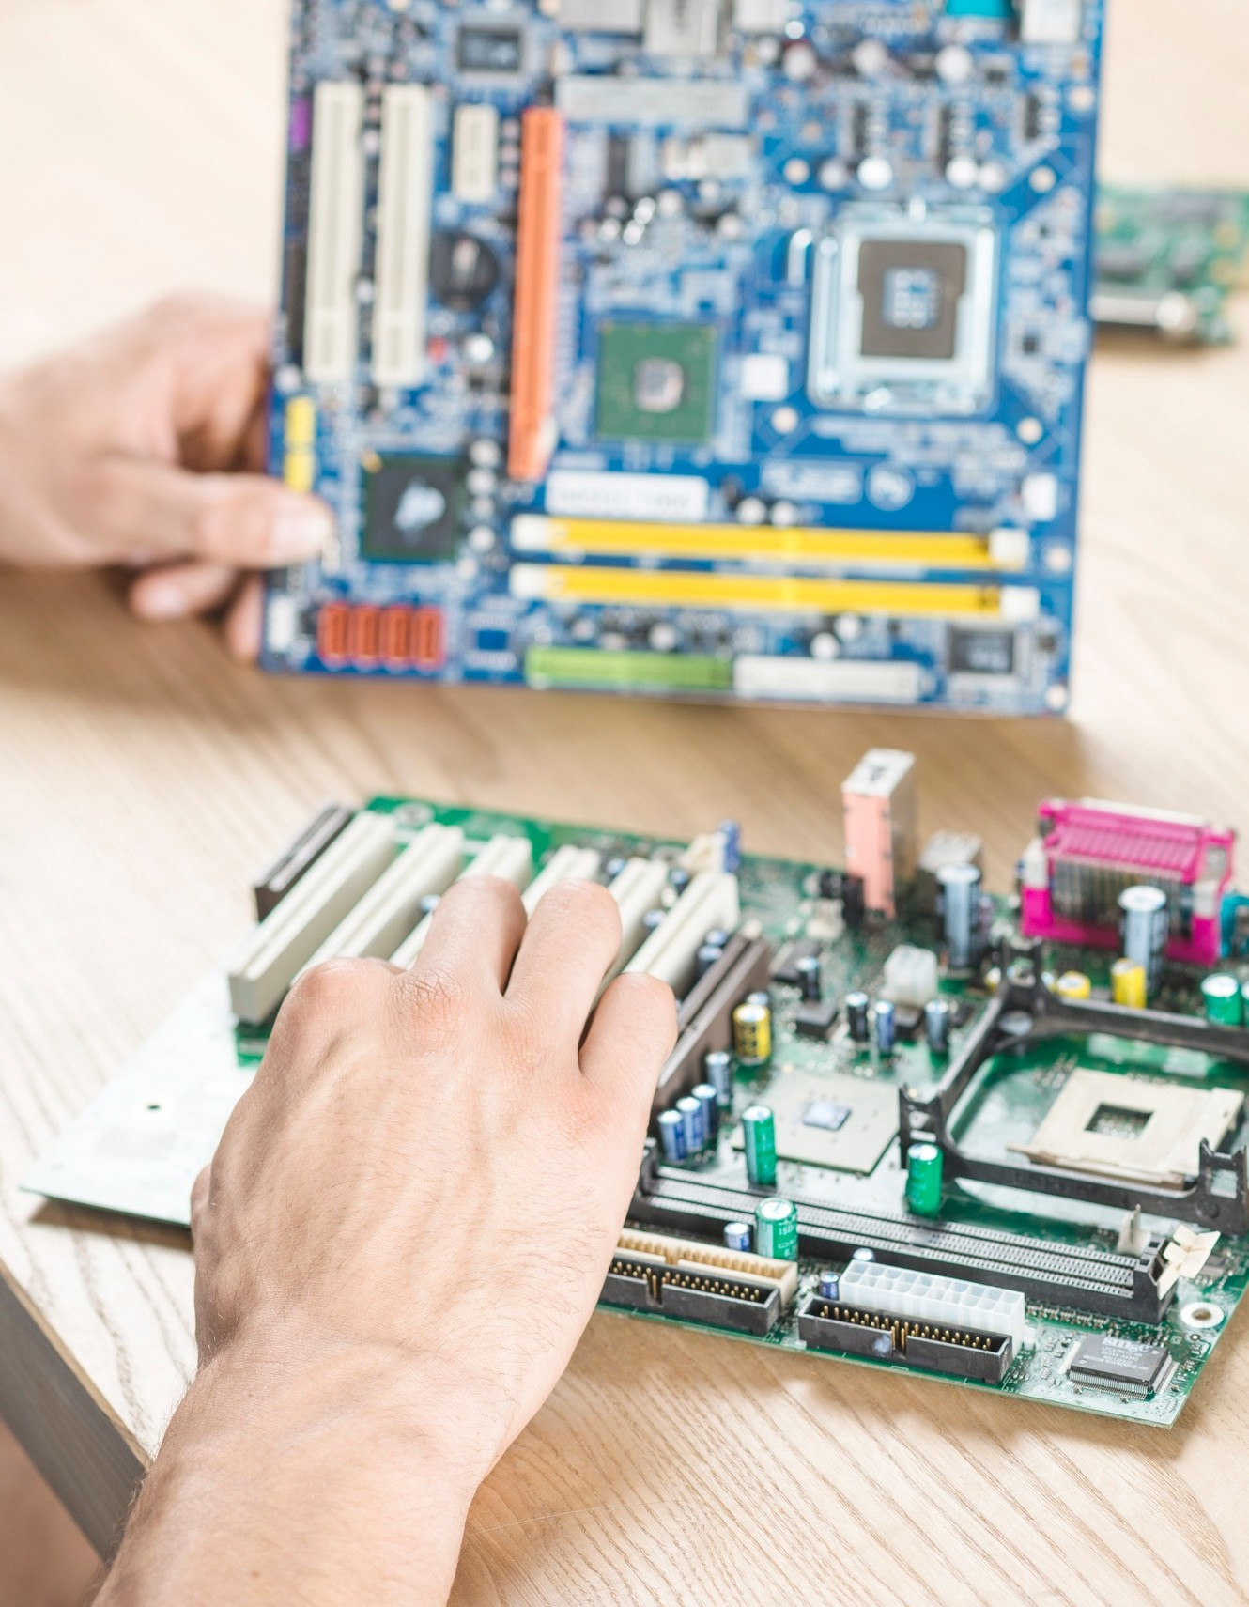


Hardware Implementation
Implementing DFAs in can signiﬁcantly improve processing speed. This slide discusses various hardware architectures suitable for DFA implementation, including and designs. We will explore the trade-offs between ﬂexibility and performance in hardware solutions.

Slide 8



Case Studies
This slide presents several
where DFAs have been successfully optimized for speciﬁc applications.
Examples include
and
systems. Analyzing these cases highlights the practical beneﬁts of effective DFA design and optimization.

Slide 9




Conclusion
In conclusion, enhancing
through the design and optimization of
in hardware is crucial for various applications. By employing effective design methodologies and optimization techniques, we can achieve signiﬁcant improvements in performance and efﬁciency.

Slide 10
Thanks!
Do you have any questions?

